Slide 2
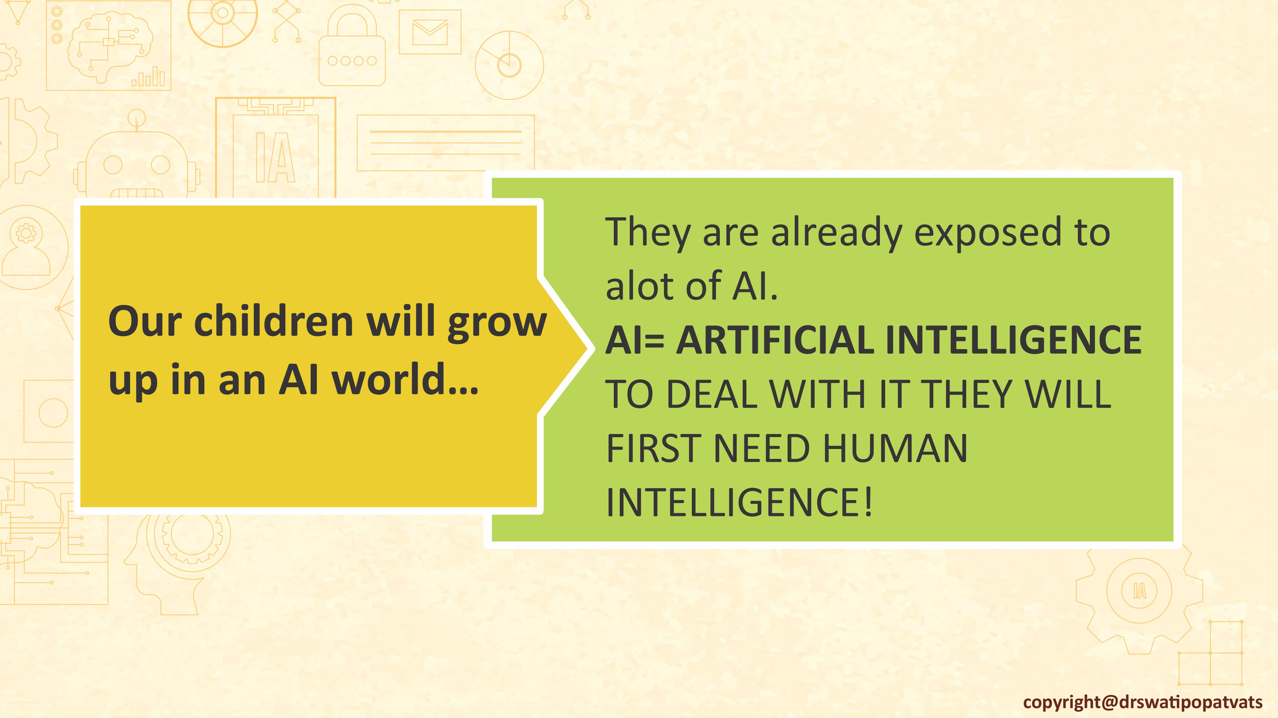

Slide 3
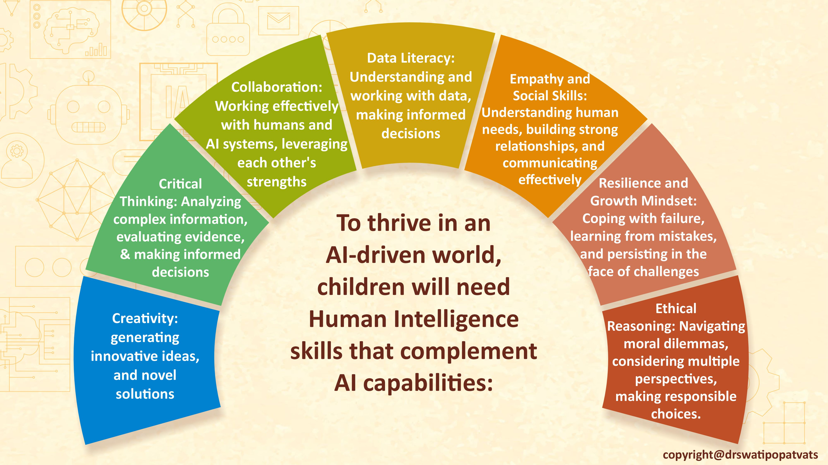

Slide 9
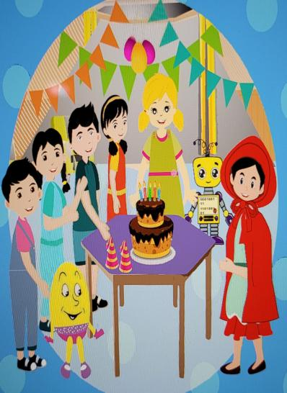
S.T.E.A.M During
story telling…
Show a picture or a story- predict what will happen next.

Slide 26
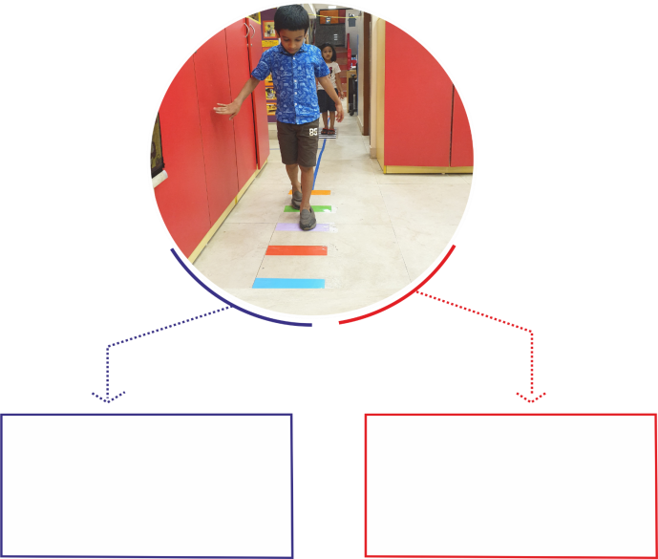
Learning about instructions
learn how to follow instructions and move their body to complete the game or the maze given
Game instructions to move on a specified pattern during outdoor play

Slide 34
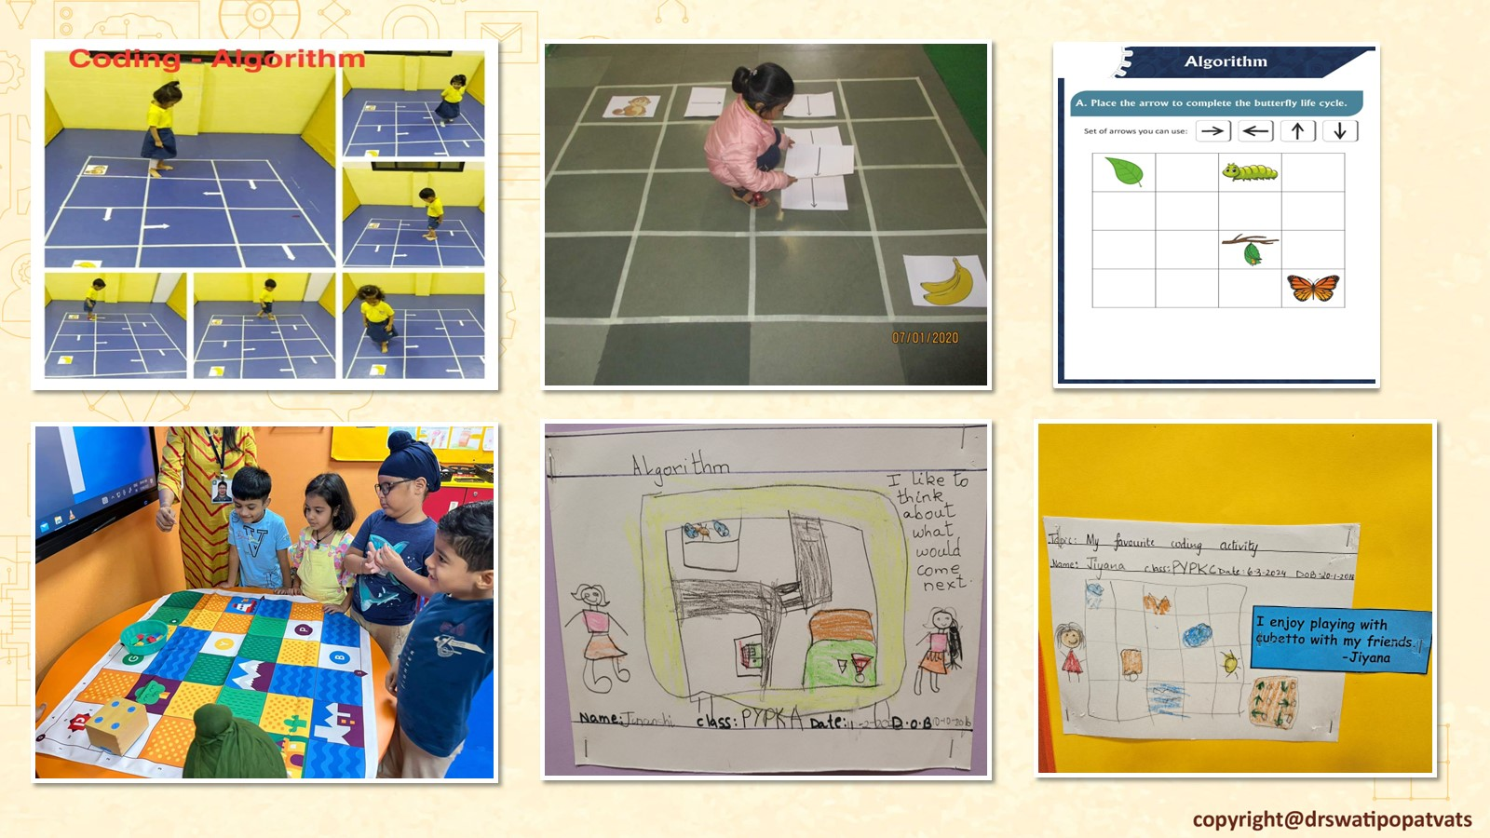

Slide 45
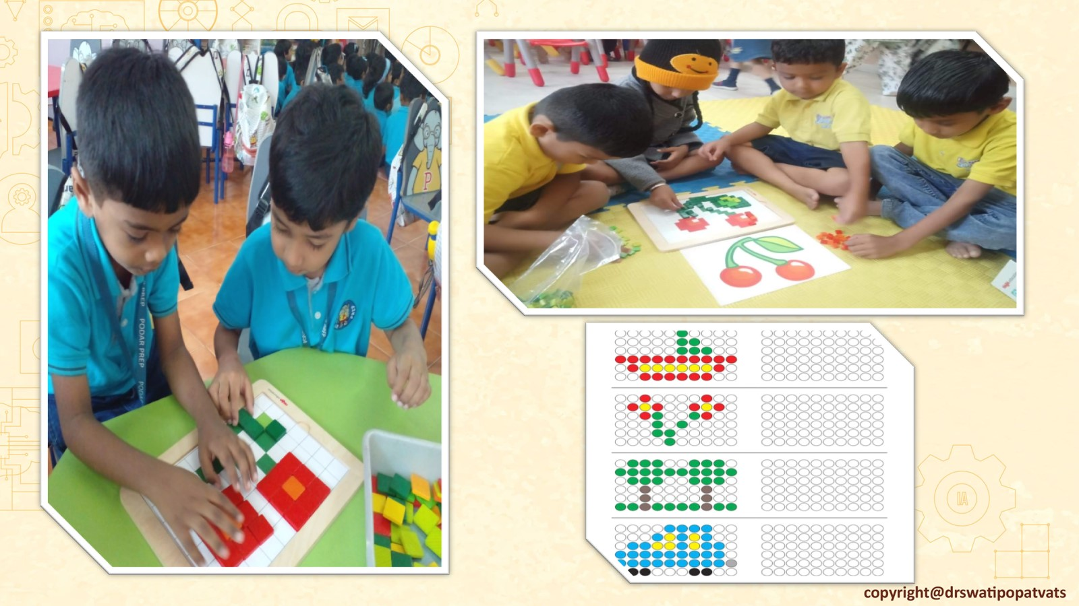

Slide 69
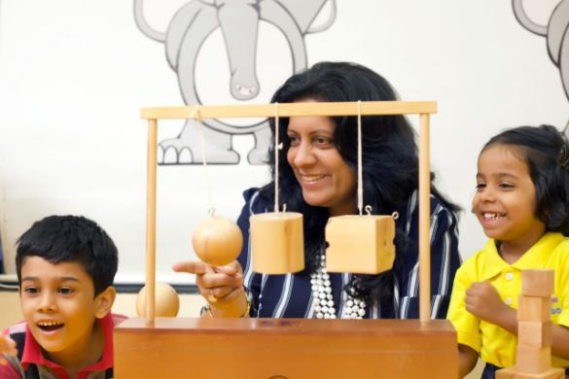
Books written by
Dr. Swati Popat Vats
President
Early Childhood Association
Association for Primary Education and Research
ecapresidentindia@gmail.com

