Slide 1
Collated copyright ©️ Dr Swati Popat Vats

Slide 2
Collated copyright ©️ Dr Swati Popat Vats

Slide 3
Collated copyright ©️ Dr Swati Popat Vats

Slide 4
Collated copyright ©️ Dr Swati Popat Vats

Slide 5
Collated copyright ©️ Dr Swati Popat Vats

Slide 6
Collated copyright ©️ Dr Swati Popat Vats

Slide 7
Collated copyright ©️ Dr Swati Popat Vats

Slide 8
Collated copyright ©️ Dr Swati Popat Vats

Slide 9
Collated copyright ©️ Dr Swati Popat Vats

Slide 10
Collated copyright ©️ Dr Swati Popat Vats

Slide 11
Collated copyright ©️ Dr Swati Popat Vats

Slide 12
Collated copyright ©️ Dr Swati Popat Vats

Slide 13
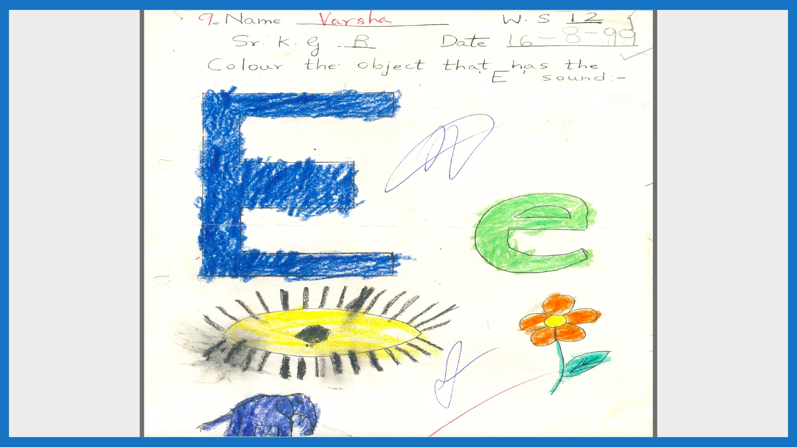
Collated copyright ©️ Dr Swati Popat Vats

Slide 14
Collated copyright ©️ Dr Swati Popat Vats

Slide 15
Collated copyright ©️ Dr Swati Popat Vats

Slide 16
Collated copyright ©️ Dr Swati Popat Vats

Slide 17
Collated copyright ©️ Dr Swati Popat Vats

Slide 18
Collated copyright ©️ Dr Swati Popat Vats

Slide 19
Collated copyright ©️ Dr Swati Popat Vats

Slide 20
Collated copyright ©️ Dr Swati Popat Vats

Slide 21
Collated copyright ©️ Dr Swati Popat Vats

Slide 22
Collated copyright ©️ Dr Swati Popat Vats

Slide 23
Collated copyright ©️ Dr Swati Popat Vats

Slide 24
Collated copyright ©️ Dr Swati Popat Vats

Slide 25
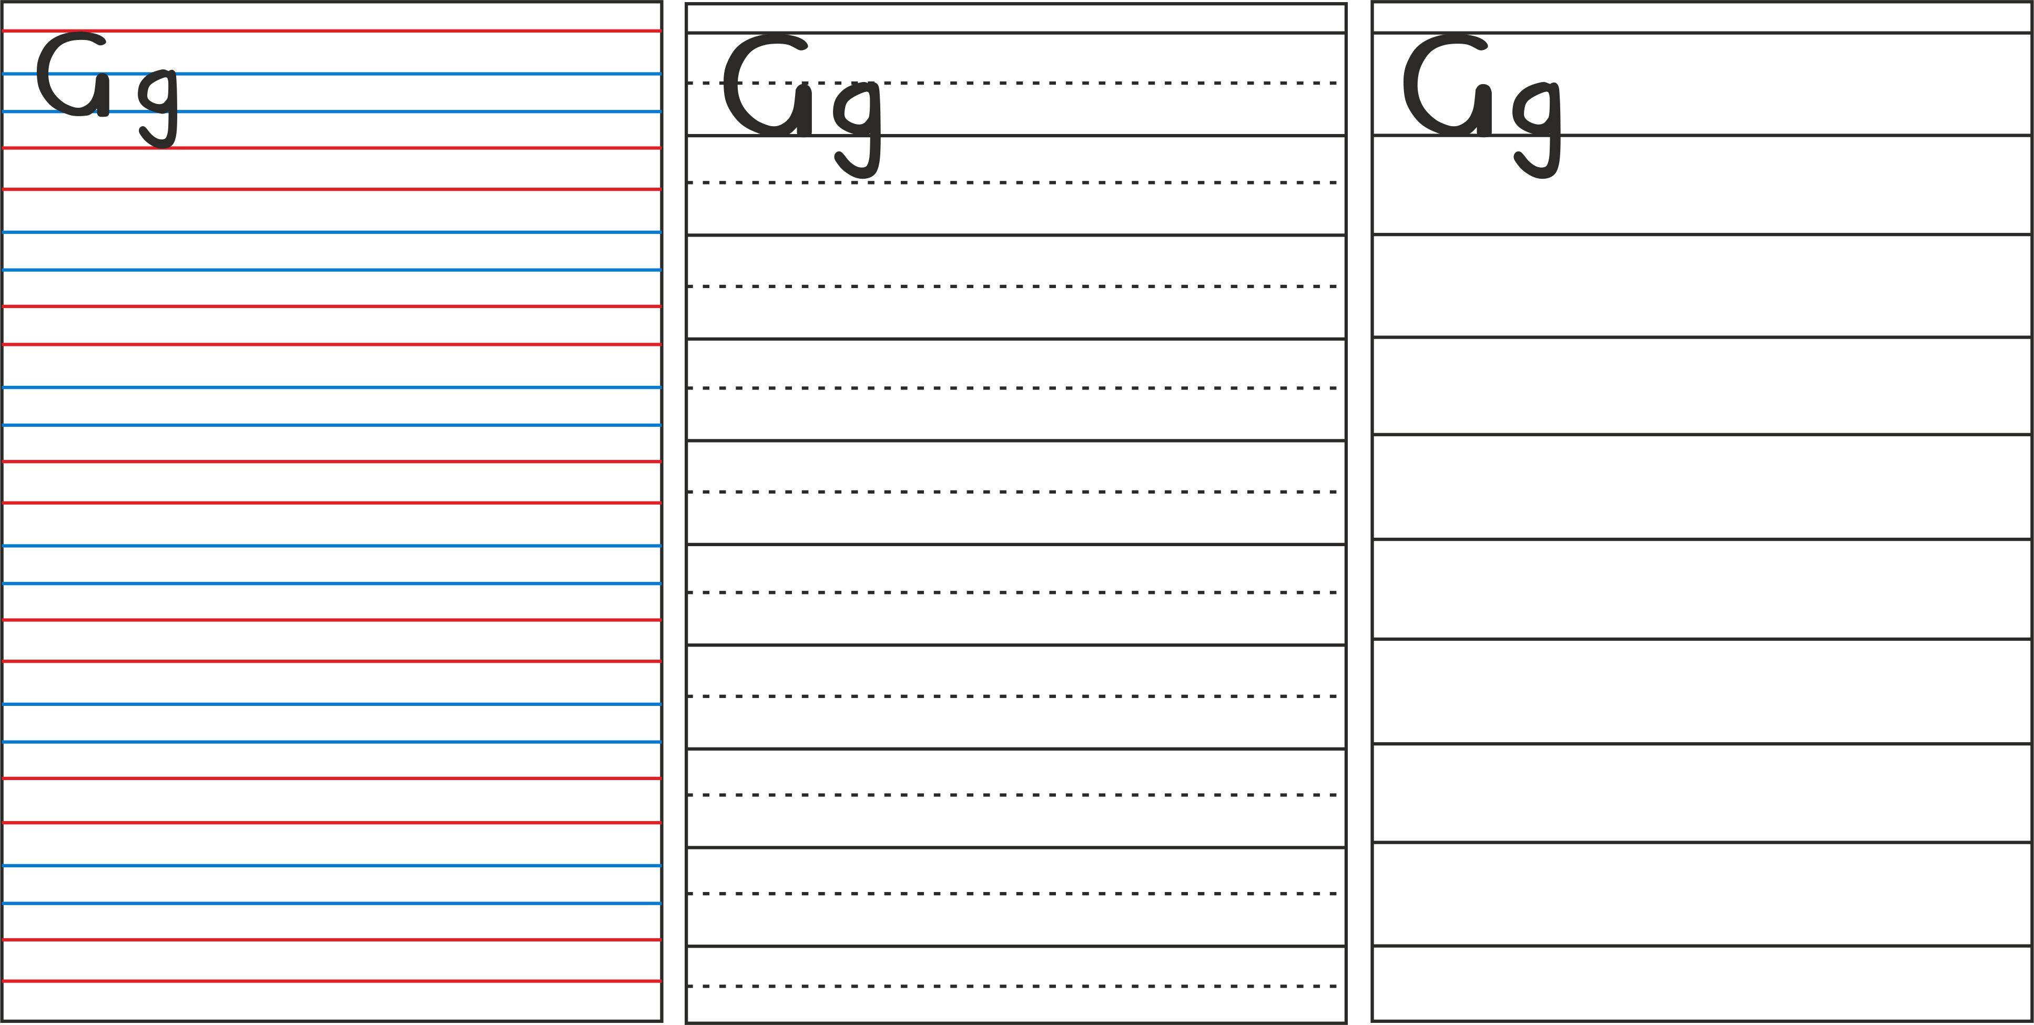
Collated copyright ©️ Dr Swati Popat Vats

Slide 26
Collated copyright ©️ Dr Swati Popat Vats

Slide 27
Collated copyright ©️ Dr Swati Popat Vats

Slide 28
Collated copyright ©️ Dr Swati Popat Vats

Slide 29
Collated copyright ©️ Dr Swati Popat Vats

Slide 30
Collated copyright ©️ Dr Swati Popat Vats

Slide 31
Collated copyright ©️ Dr Swati Popat Vats

Slide 32
Collated copyright ©️ Dr Swati Popat Vats

Slide 33
Collated copyright ©️ Dr Swati Popat Vats

Slide 34
Collated copyright ©️ Dr Swati Popat Vats

Slide 35
Collated copyright ©️ Dr Swati Popat Vats

Slide 36
Collated copyright ©️ Dr Swati Popat Vats

Slide 37
Collated copyright ©️ Dr Swati Popat Vats

Slide 38
Collated copyright ©️ Dr Swati Popat Vats

Slide 39
Collated copyright ©️ Dr Swati Popat Vats

Slide 40
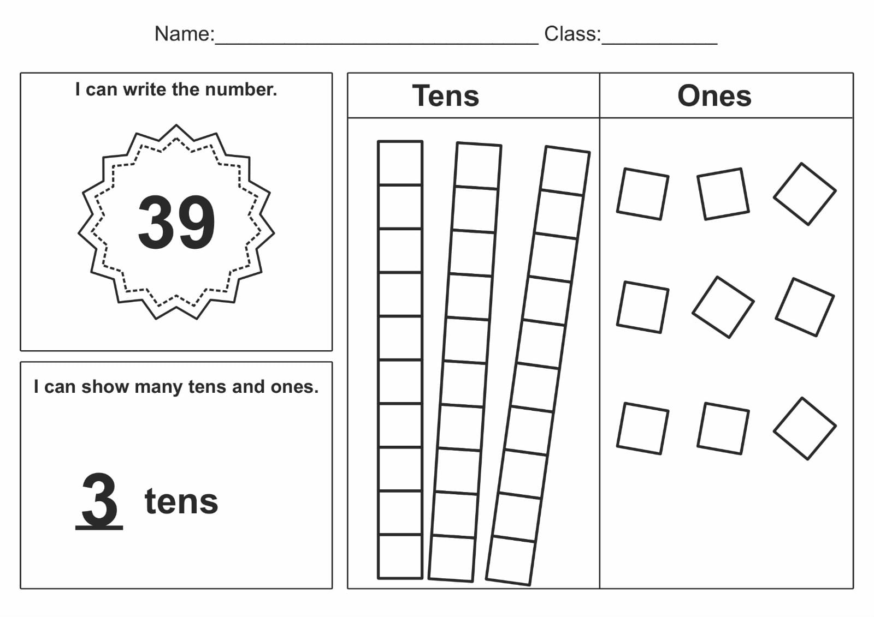
Collated copyright ©️ Dr Swati Popat Vats

Slide 41
Collated copyright ©️ Dr Swati Popat Vats

Slide 42
Collated copyright ©️ Dr Swati Popat Vats

Slide 43
Collated copyright ©️ Dr Swati Popat Vats

Slide 44
Collated copyright ©️ Dr Swati Popat Vats

Slide 45
Collated copyright ©️ Dr Swati Popat Vats

Slide 46
Collated copyright ©️ Dr Swati Popat Vats

Slide 47
Collated copyright ©️ Dr Swati Popat Vats

Slide 48
Collated copyright ©️ Dr Swati Popat Vats

Slide 49
Collated copyright ©️ Dr Swati Popat Vats

Slide 50
Collated copyright ©️ Dr Swati Popat Vats

Slide 51
Collated copyright ©️ Dr Swati Popat Vats

Slide 52
Collated copyright ©️ Dr Swati Popat Vats

Slide 53
Collated copyright ©️ Dr Swati Popat Vats

Slide 54
Collated copyright ©️ Dr Swati Popat Vats

Slide 55
CHILDREN MAY BE 20% OF OUR PRESENT BUT THEY ARE 100% OUR FUTURE.
GIVE YOUR 100% TO YOUR FUTURE TODAY.
swatipopatvatskiducation@blogspot.in
Collated copyright ©️ Dr Swati Popat Vats

